Slide 1
Lang Xin Pei
PIT of Page designer
2014.09
Product Implementation Training (PIT)
IBM Case Manager 5.2.1
Page Designer Improvements

Slide 2
Introduction
Course Overview
This session covers the new improvements to and behavior changes when designing a page in a solution
Target Audience:
IBM Case Manager Support Teams (L2,L3)
ECM Lab Services
IBM GBS and GTS
Technical Sales
Prerequisites:
Working knowledge of ICM 5.2, Solution Design, Page Design and Page Widget/Action
Version Release Date: September, 2014
© Copyright International Business Machines Corporation 2014. All Rights Reserved.
US Government Users Restricted Rights - Use, duplication or disclosure restricted by GSA ADP Schedule Contract with IBM Corp.

Slide 3
Course Objectives
After this course you will be familiar with the:
New page layouts introduced in Case Manager 5.2.1
New page widgets and widget settings introduced in Case Manager 5.2.1
Improvements that can be leveraged when designing a page

Slide 4
Course Roadmap
New page layout in page designer
New widgets/actions and related settings when designing a page
Operation improvements in designing a page
Widget layout changing behavior
Widget filter
Widget property change
Tracking widget version change when designing a page
Course summary

Slide 5
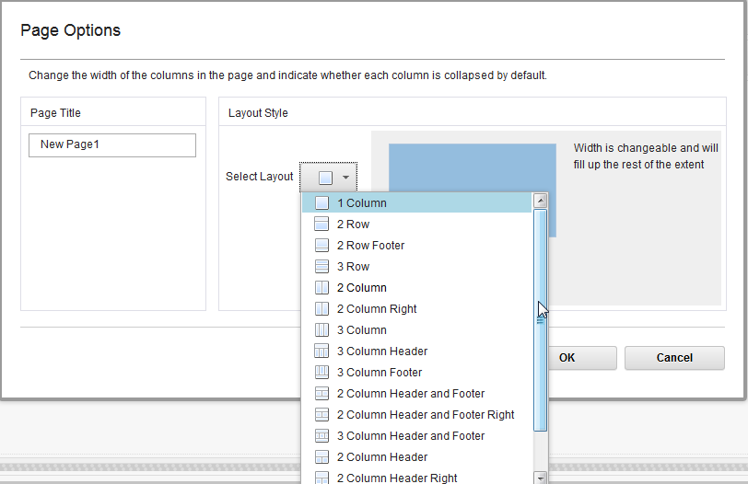
New page layout in page designer
8 new page layouts are introduced
2 Row Footer
3 Row
2 Column Right
3 Column Footer
2 Column Header and Footer Right
3 Column Header and Footer
2 Column Footer Right
2 Column Header Right

Slide 6
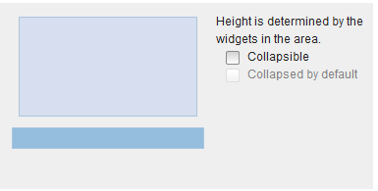
New page layout in page designer (cont.)
2 Row Footer

Slide 7
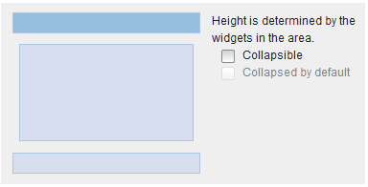
New page layout in page designer (cont.)
3 Row

Slide 8
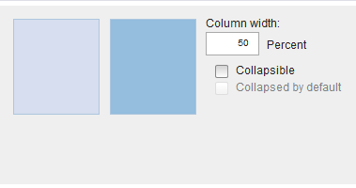
New page layout in page designer (cont.)
2 Column Right
Right region can be collapsible

Slide 9
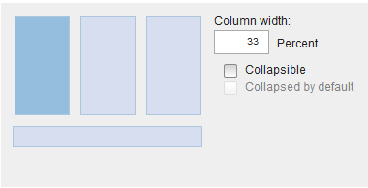
New page layout in page designer (cont.)
3 Column Footer

Slide 10
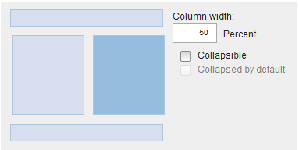
New page layout in page designer (cont.)
2 Column Header and Footer Right
Right region can be collapsible

Slide 11
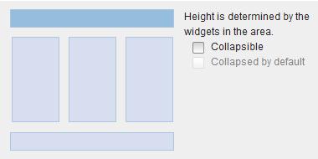
New page layout in page designer (cont.)
3 Columns Header and Footer

Slide 12
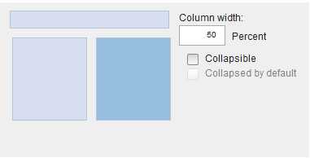
New page layout in page designer (cont.)
2 Column Header Right
Right region can be collapsible

Slide 13
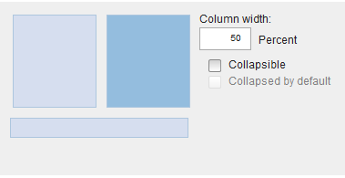
New page layout in page designer (cont.)
2 Column Footer Right
Right region can be collapsible

Slide 14
Course Roadmap
New page layout in page designer
New widgets/actions and related settings when designing a page
Operation improvements when designing a page
Widget layout changing behavior
Widget filter
Widget property change
Tracking widget version changes when designing a page
Course summary

Slide 15

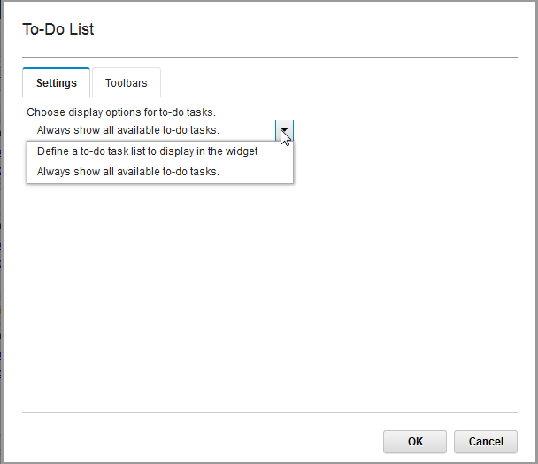
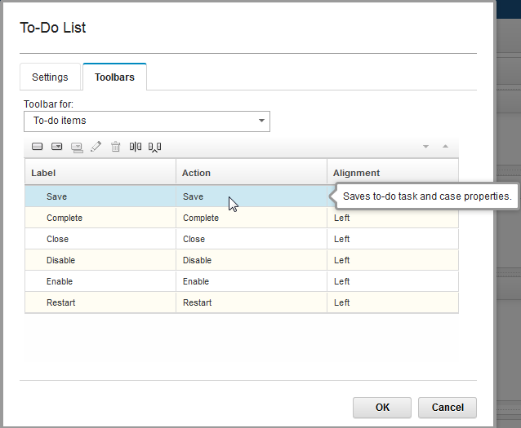
New page widget
One new widget is introduced in the widget palette
To-Do List Widget

Slide 16
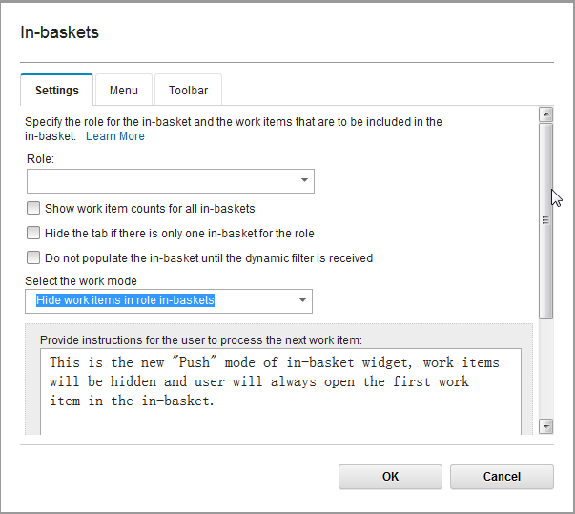
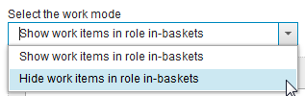
New page widget
In-basket widget is extended to support “Push” mode which can be enabled using a widget setting.

Slide 17
New actions
Seven new ToDo task-related actions are included in the action resources
Close: Close a ToDo View
Complete: Complete a ToDo task
Save: Save ToDo task property changes
Restart: Restart a ToDo task
Start: Start a ToDo task
Enable: Enable a ToDo task
Disable: Disable a ToDo task

Slide 18
Course Roadmap
New page layout in page designer
New widgets/actions and related settings when designing a page
Operation improvements when designing a page
Widget layout changing behavior
Widget filter
Widget property change
Tracking widget version changes when designing a page
Course summary

Slide 19
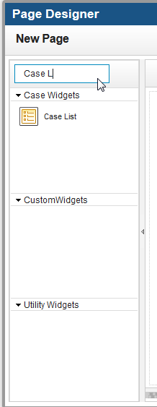
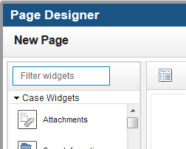
Operation improvements: widget filter change
Widget filter in widget palette

Slide 20
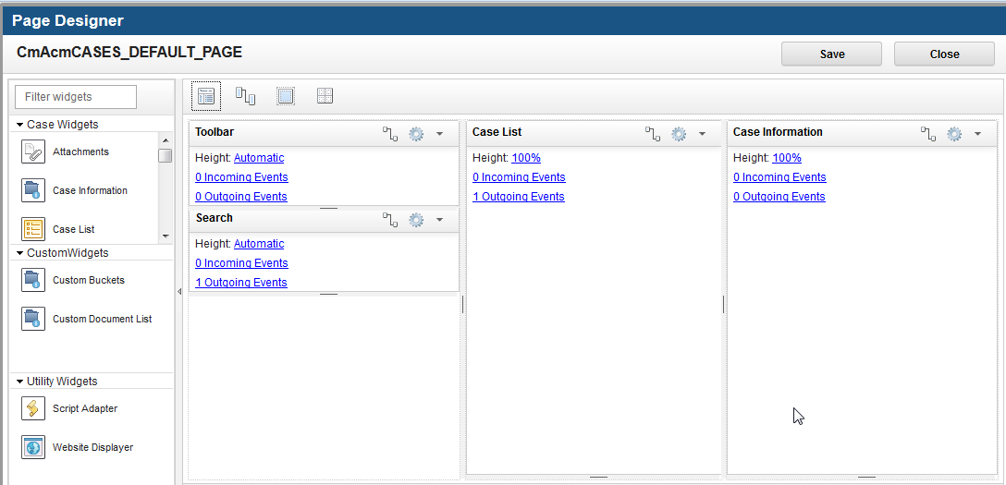
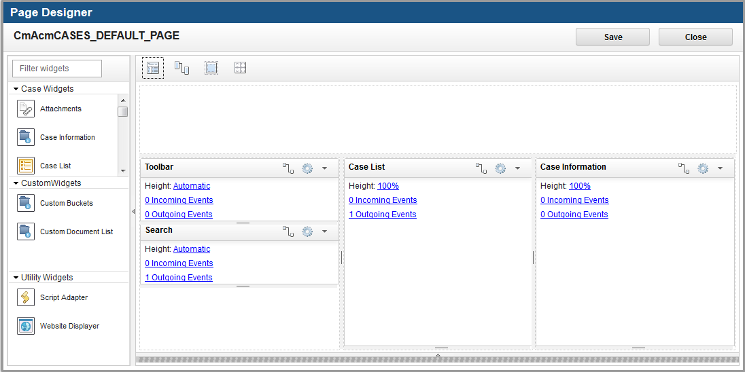
Operation improvements: widget layout change
Behavior changes when switching between page layouts
When the user changes the page layout from one type to another
Previous behavior: Existing widgets are all put into the first region of the new layout.
New behavior: Existing widgets will first try to move into the same region in the new layout, if the same region doesn’t exist in the new layout, the widget will be put into the first region.
New behavior saves time as it limits how much widget repositioning is needed
Before change layout (3 column)
After change layout ( 3 Column Header

Slide 21
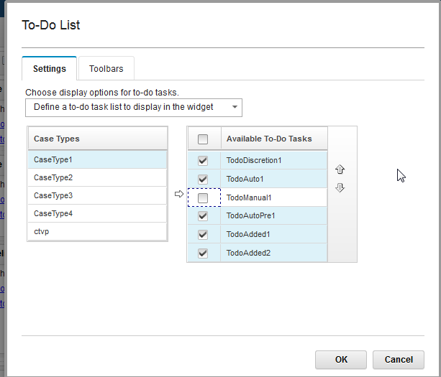
Operation improvements: widget property change
Widget property change
New widget property type: “casetypeTaskSelector”
Sample:
The widget property is defined in the To-Do List widget. Use it to define a ToDo Task List as well as the sequence of the tasks in the list.
{
"propertyType": "property",
"type": "casetypeTaskSelector",
"id": "taskList",
"required": false,
"visibility": true,
"title": "Define a to-do task list to display in the widget“
}

Slide 22
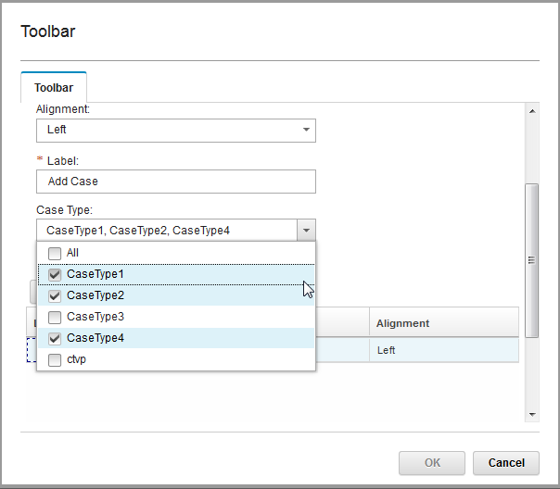
Operation improvements: widget property change (cont.)
Widget property change
New widget property type “multi-caseType” that can be used in the Add Case action
Other similar new property types supporting multiple values: multi-task/multi-view/multi-role
Sample:
The widget property defined in Add Case action.
{
"id": "caseType",
"title": “Add Case”,
"defaultValue": "All",
"type": "multi-caseType"
},

Slide 23
Course Roadmap
New page layout in page designer
New widgets/actions and related settings when designing a page
Operation improvements when designing a page
Widget layout changing behavior
Widget filter
Widget property change
Tracking widget version changes when designing a page
Course summary

Slide 24
Tracking widget version changes
ICM OOTB widget version is upgraded from ICM “5.2” to ICM “5.2.1”
When a page is saved in a solution, the widgets included in the page as well as its version and widget setting information are also saved in the page.
Page Designer will check the widget version and setting information of widgets included in the page during the page opening. So
If a widget’s version which is registered in the system does not synchronize with that in the page, the page designer will display a message in that widget’s panel to remind user.
During the edit of a page built upon the old version widgets, the user can choose to double check version-unmatching widget’s setting or ignore the warning message and override the widget with the latest widget setting during the page saving.
Generally, the widget version update means possible changes in widget’s setting, event definition or function. And for the ICM OOTB widgets, in the runtime the latest ICM OOTB widgets are compatible with old version widget setting in the page.
Custom widget has the same behavior after it registers with the new version in the system and try to edit the old page which contains the custom widget.

Slide 25
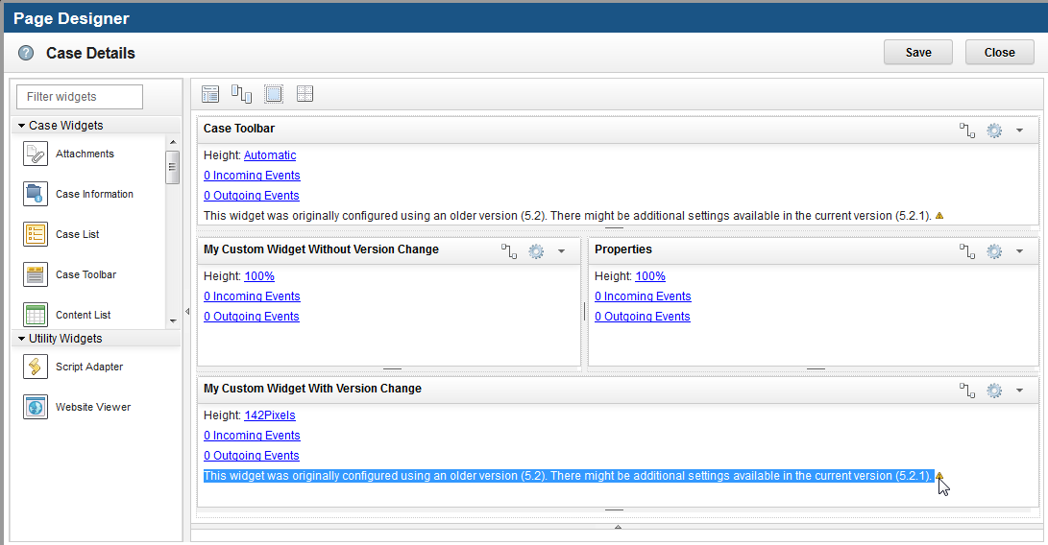
Tracking widget version changes (cont.)
Widget version updated reminding message in page designer
Saving the page will clean the message.

Slide 26
Course Roadmap
New page layout in page designer
New widgets/actions and related settings when designing a page
Operation improvements when designing a page
Widget layout changing behavior
Widget filter
Widget property change
Tracking widget version changes when designing a page
Course summary

Slide 27
Course Summary
You have completed this course and can
Use the new layout types, widget and actions to design pages in different styles
Appreciate the page design improvements that enable you to
Quickly filter out widgets from a widgets list
Switch layouts with less modification of the widget positioning
Use more choices when defining or configuring a widget’s properties

Slide 28
Contacts
Product Marketing Manager:
William D. (Doc) Mills (wdocmills@us.ibm.com)
Product Manager:
Dave Perman (dperman@ca.ibm.com)
Subject Matter Experts (SME)/Area of Expertise:
Victor Lang(langxp@cn.ibm.com)
Li Gai (ligai@cn.ibm.com)
Support:
Ted Dullanty (tdullanty@us.ibm.com)

Slide 29
Product Help/Documentation/Resources
IBM Case Manager 5.2.1 Knowledge Center: http://www-01.ibm.com/support/knowledgecenter/SSCTJ4_5.2.1/com.ibm.casemgmttoc.doc/casemanager_5.2.1.htm?lang=en
IBM Case Manager 5.2 Knowledge Center: http://www-01.ibm.com/support/knowledgecenter/SSCTJ4_5.2.0/com.ibm.casemgmttoc.doc/casemanager_5.2.0.htm?lang=en
IBM Content Navigator 2.0.3 Knowledge Center:http://www-01.ibm.com/support/knowledgecenter/SSEUEX_2.0.3/com.ibm.usingeuc.doc/euche001.dita?lang=en
IBM FileNet P8 5.2 Knowledge Center: http://www-01.ibm.com/support/knowledgecenter/SSNW2F_5.2.0/com.ibm.p8toc.doc/filenetcontentmanager_5.2.0.htm?lang=en
IBM Support: Fix Central http://www-933.ibm.com/support/fixcentral/

